Slide 2
Introduction to AI services
AIM001
Sama Bali
Sr. Product Marketing Manager, AI Solutions
AWS

Slide 3

What is it?
Artificial intelligence (AI)
Any technique that enables computers to mimic human intelligence using logic, if-then statements, and machine learning
Machine learning (ML)
A subset of AI that uses machines to search for patterns in data to build logic models automatically
Deep learning (DL)
A subset of ML composed of deeply multi-layered neural networks that perform tasks like speech and image recognition
Reinforcement learning (RL)
Reinforcement learning trains models by using a reward function of a desired outcome

Slide 4


















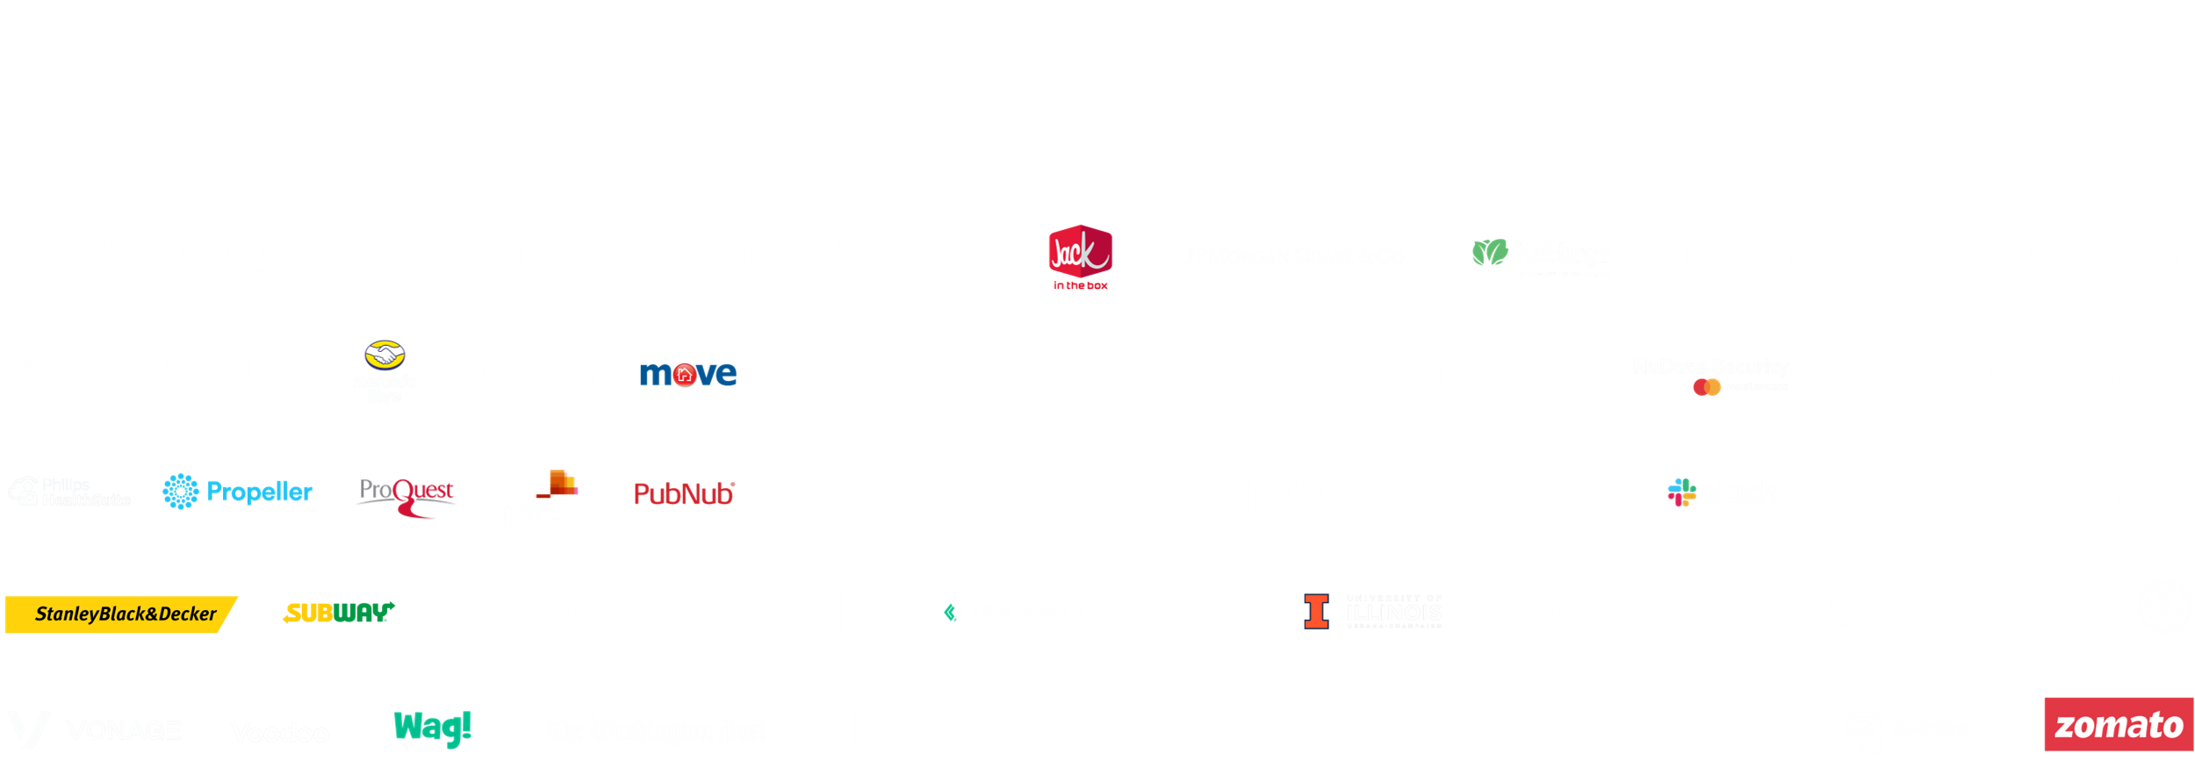
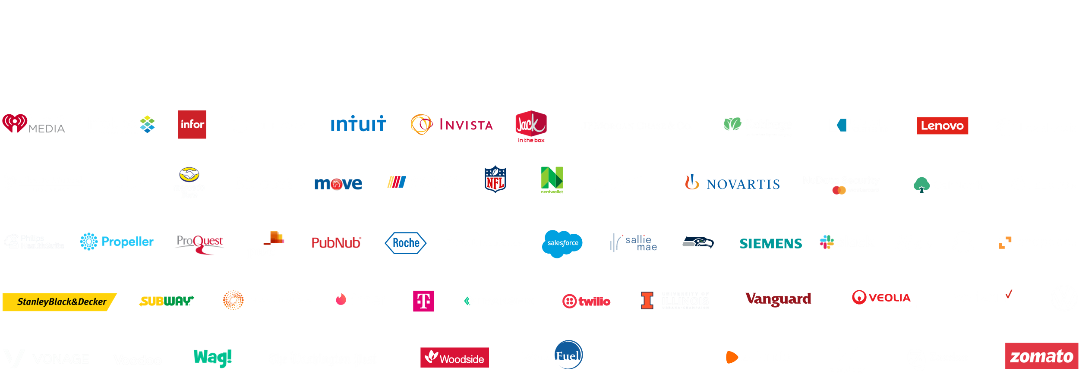















100,000+ customers use AWS for machine learning
BMW GROUP
BUNDESLIGA
Fannie Mae
NFL

Slide 5
The AWS AI/ML stack
Broadest and most complete set of machine learning capabilities
SPECIALIZED
Business processes
Amazon Personalize
Amazon Forecast
Amazon Fraud Detector
Amazon Lookout for Metrics
Search
Amazon Kendra
Code + DevOps
Amazon CodeGuru
Amazon CodeWhisperer
Amazon DevOps Guru
Industrial
Amazon Monitron
Amazon Lookout for Equipment
Amazon Lookout for Vision
Healthcare
Amazon HealthLake
Amazon Comprehend Medical
Amazon Transcribe Medical
AI SERVICES
Core
Text & documents
Amazon Translate
Amazon Comprehend
Amazon Textract
Chatbots
Amazon Lex
Speech
Amazon Polly
Amazon Transcribe
Amazon Transcribe Call Analytics
Vision
Amazon Rekognition
AWS Panorama
SAGEMAKER Ground Truth
SAGEMAKER CANVAS
SAGEMAKER STUDIO LAB
sagemaker STUDIO | RSTUDIO
ML SERVICES
Label data
No-code ML
for business analysts
Learn ML
Prepare data
Store features
Detect bias
Build with notebooks
Train models
Tune parameters
Deploy in production
Explain predictions
Manage & monitor
Manage edge devices
CI/CD
ML FRAMEWORKS & INFRASTRUCTURE
PyTorch, Apache MXNet, TensorFlow
Amazon EC2
CPUs
GPUs
AWS Inferentia
AWS Trainium
Habana Gaudi
FPGA
Elastic inference

Slide 6
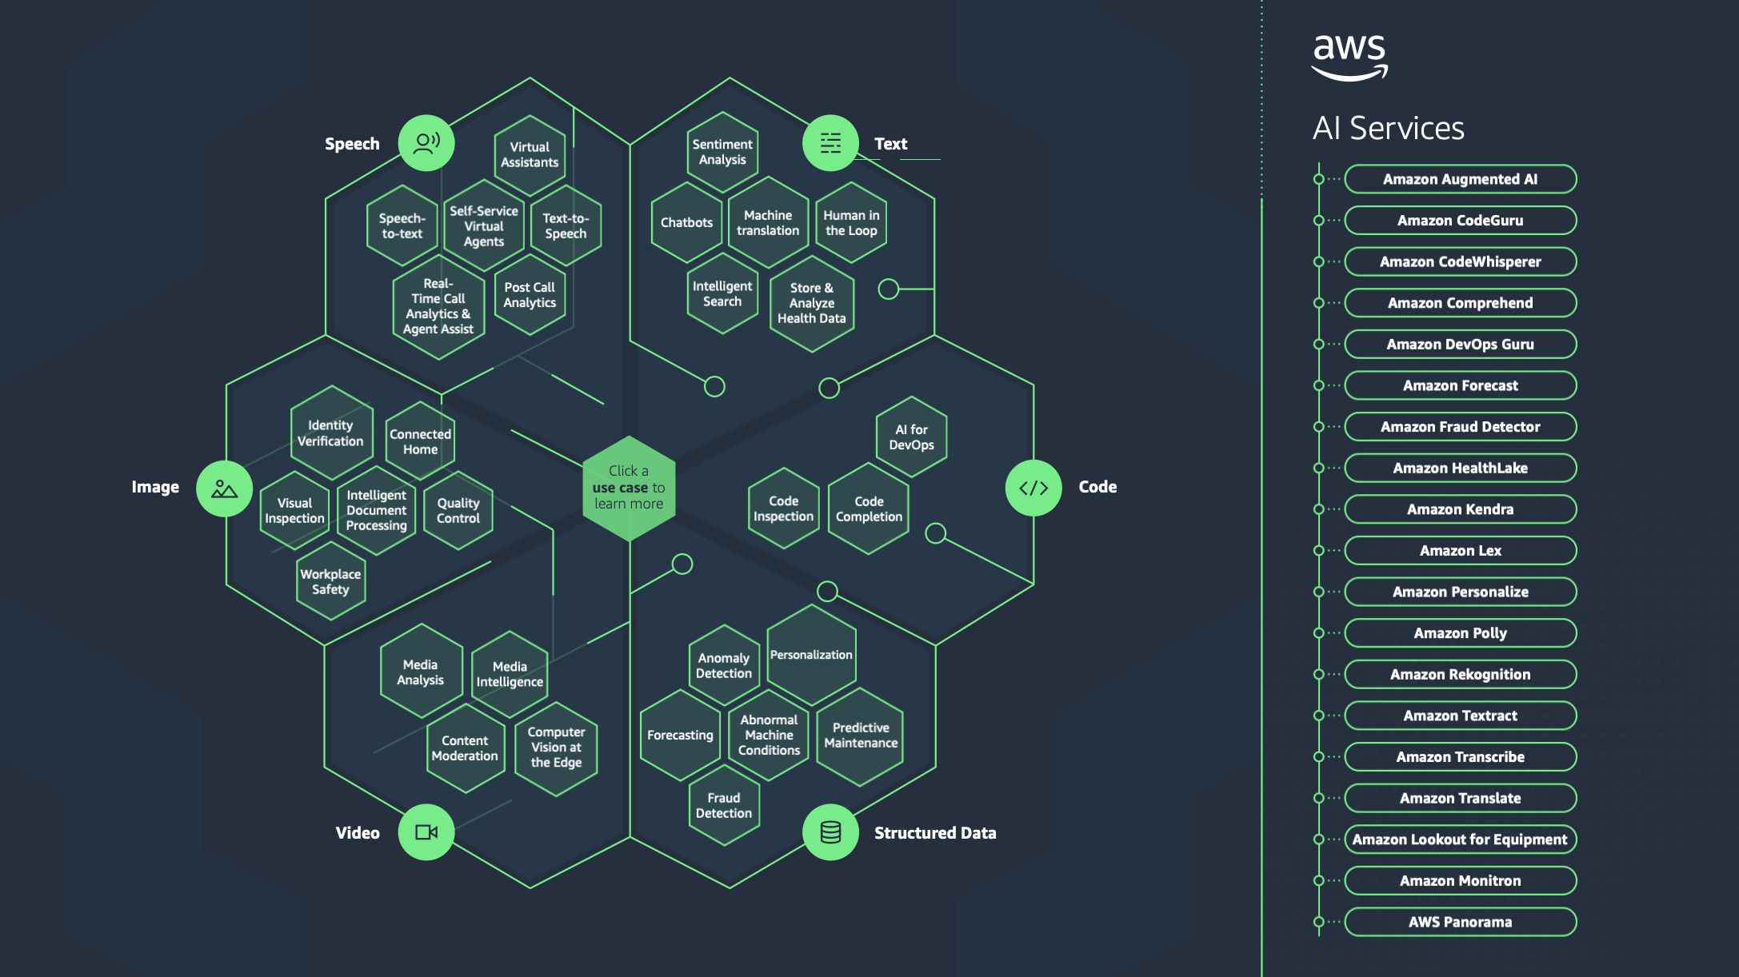

Slide 7
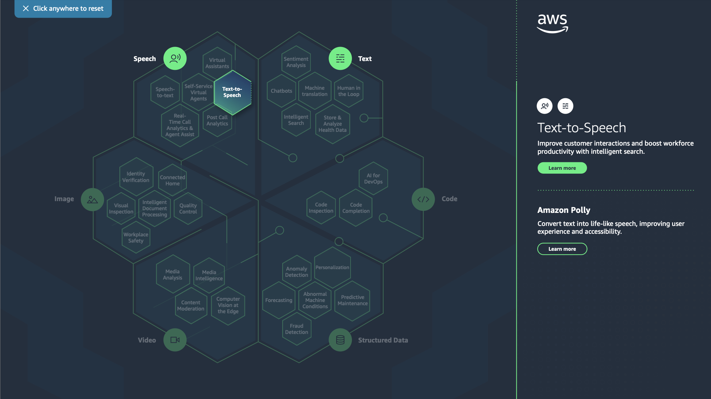


Slide 8
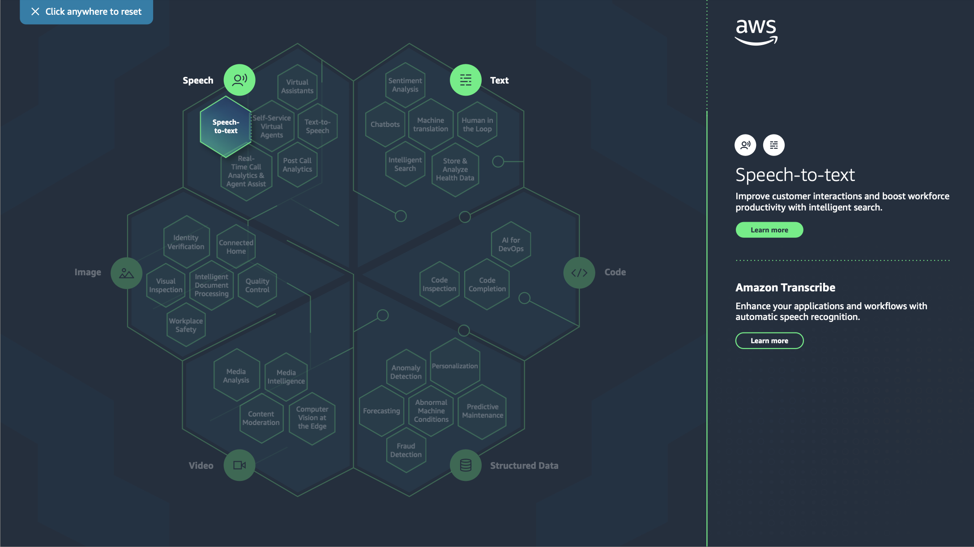

Slide 9
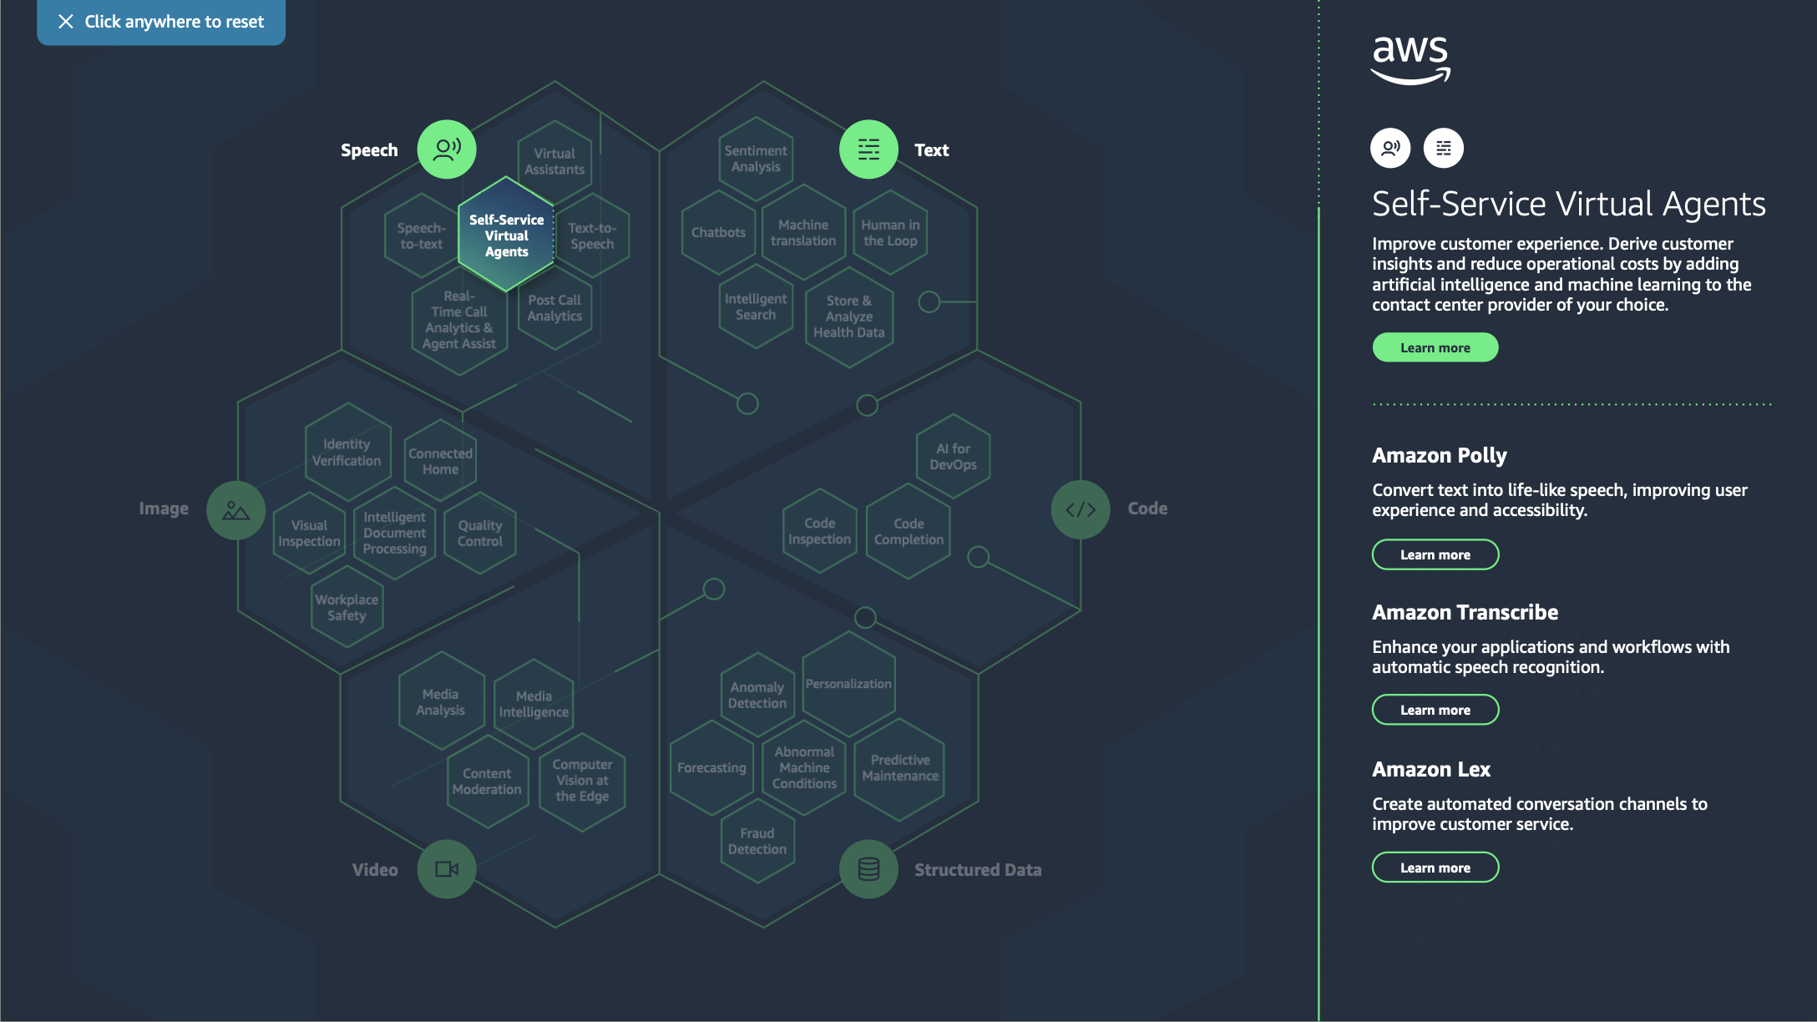

Slide 10
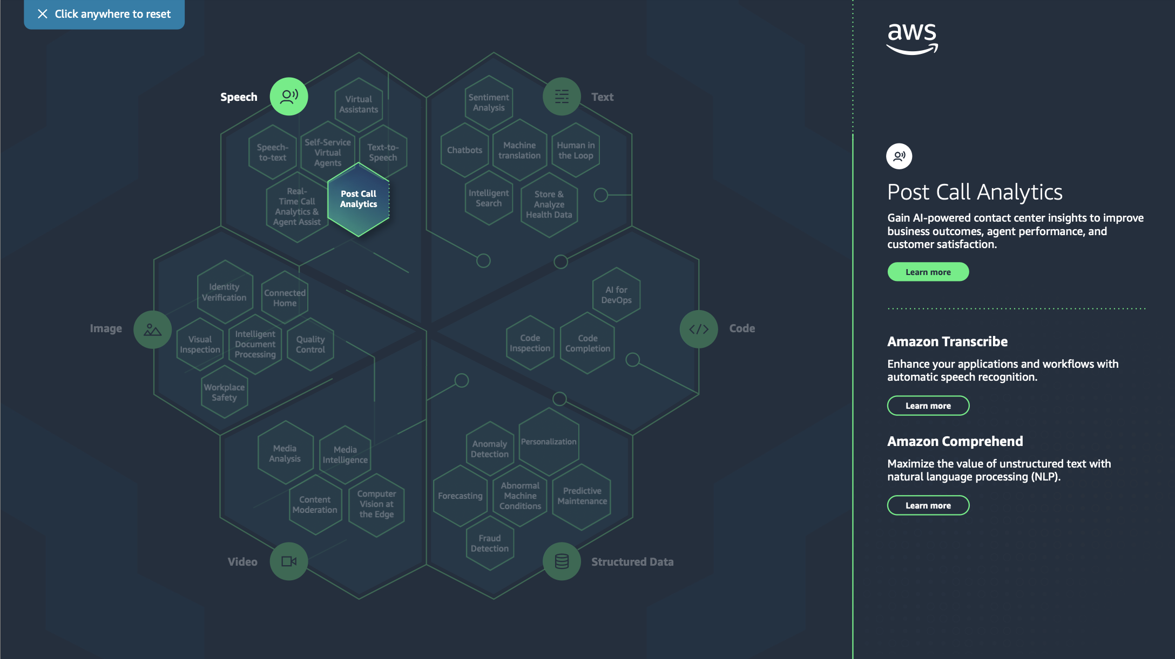

Slide 11
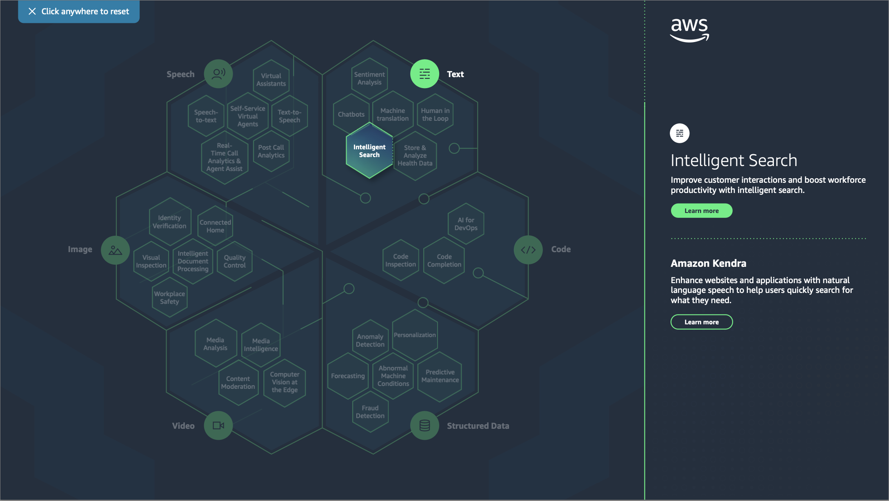

Slide 12
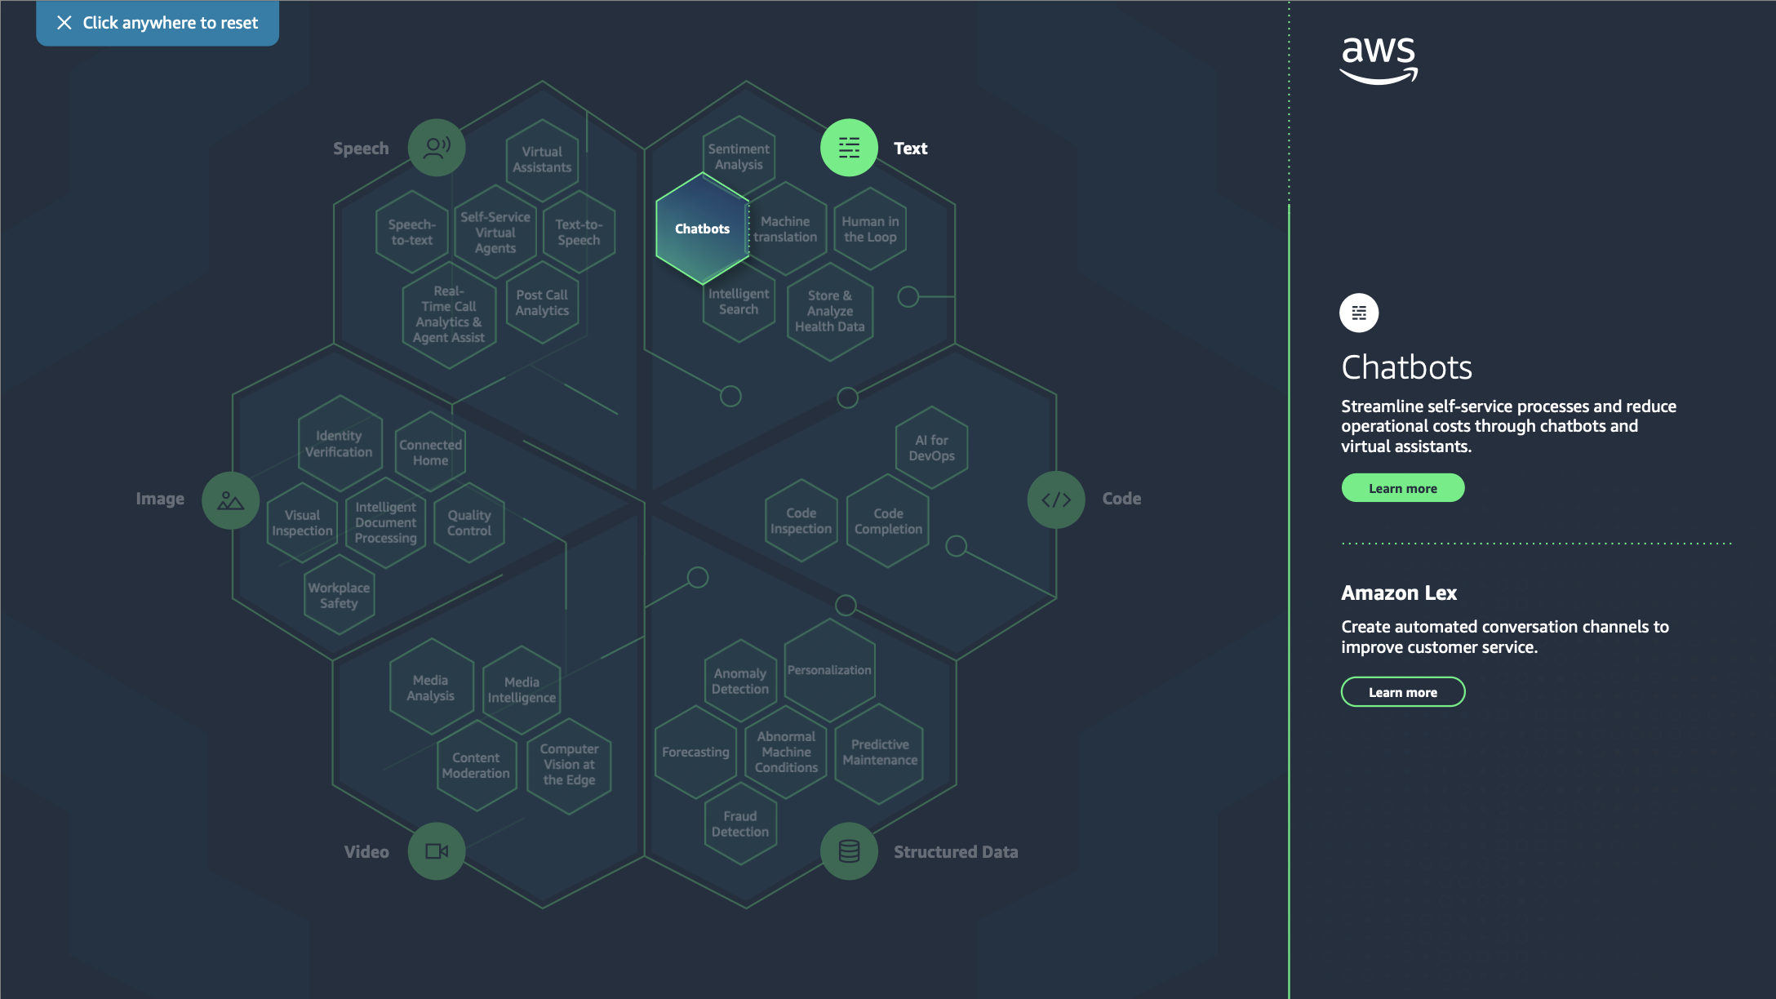

Slide 13
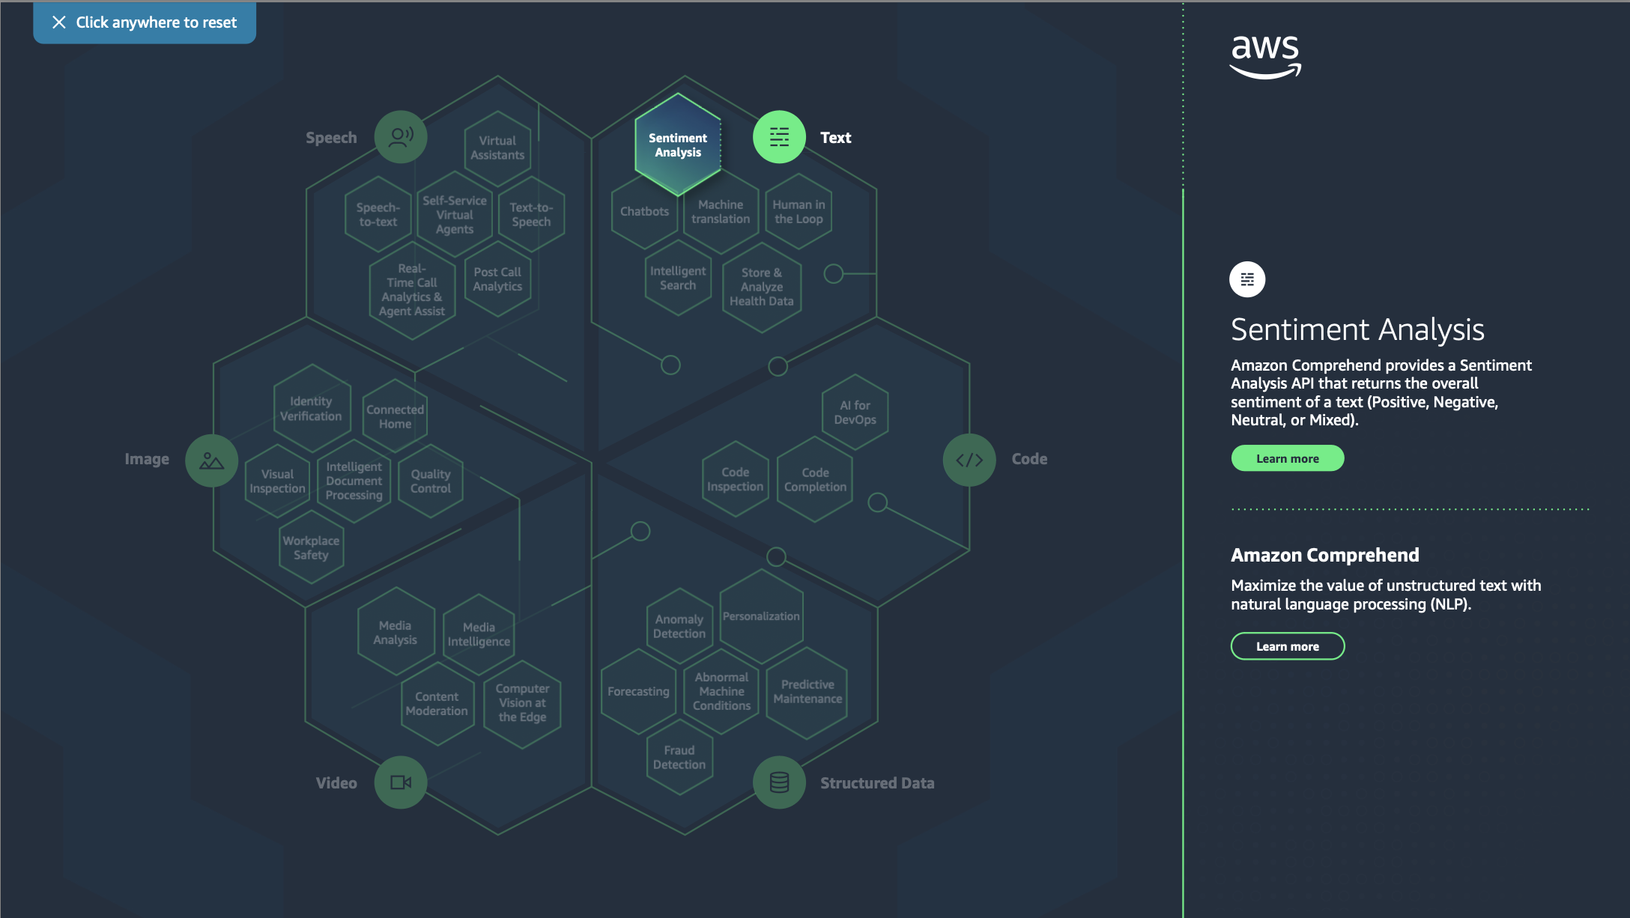


Slide 14
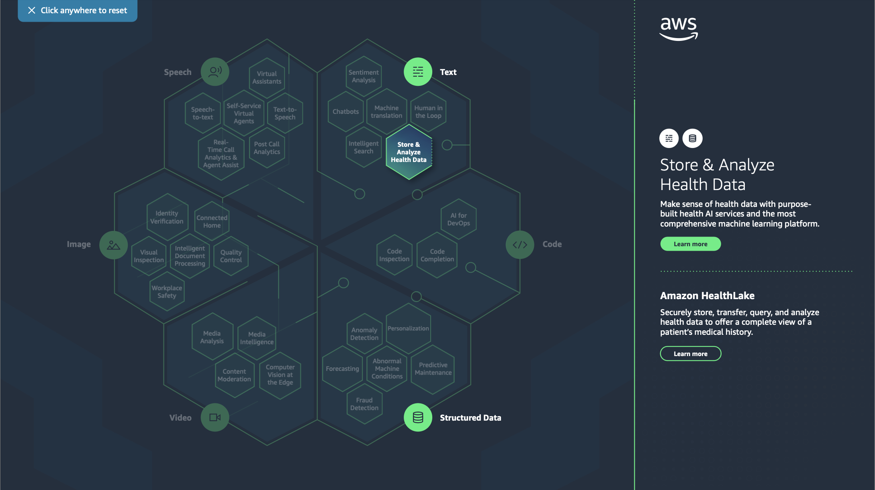

Slide 15
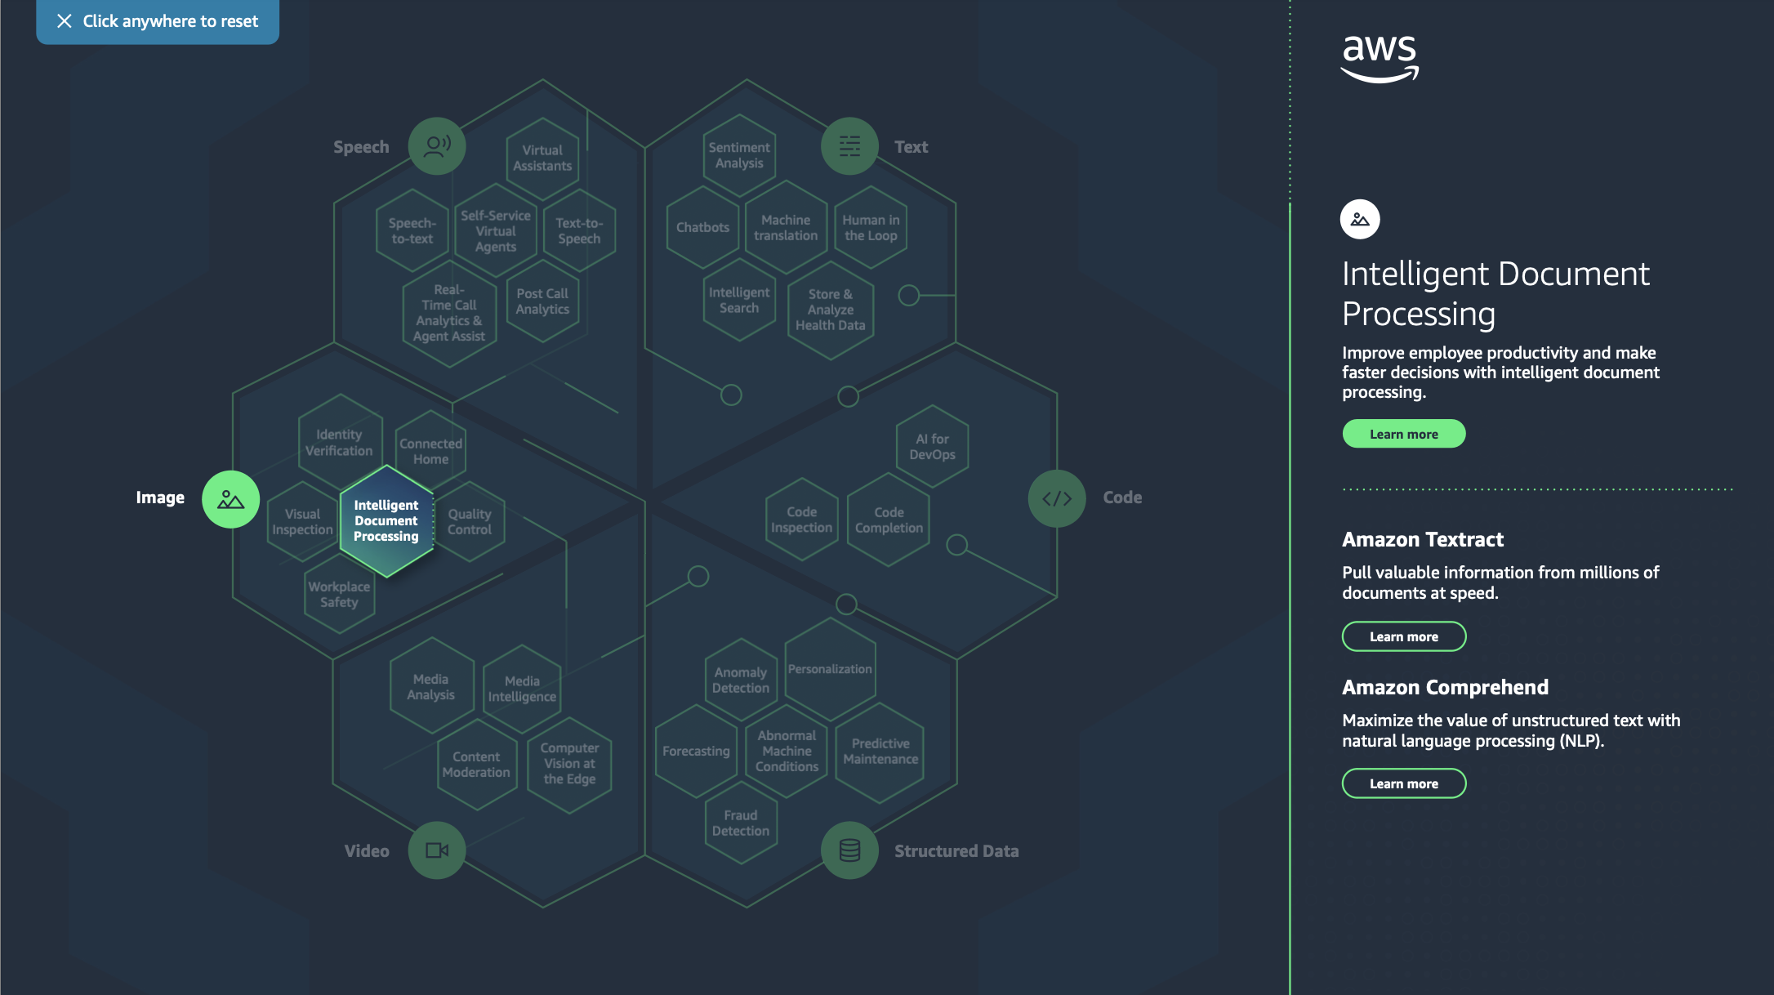

Slide 16
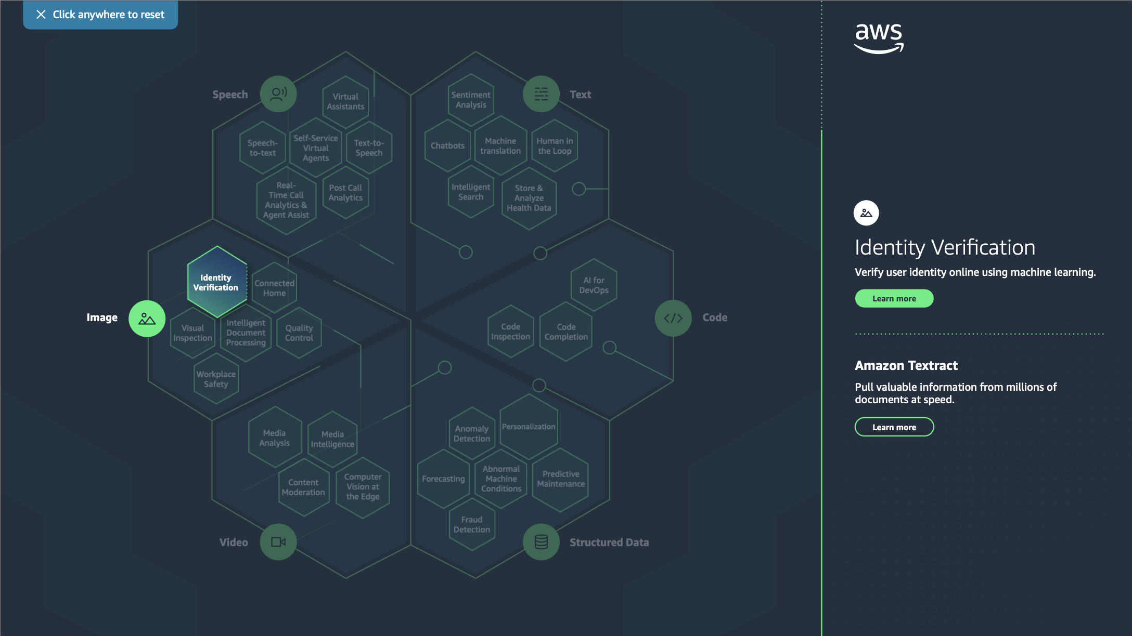
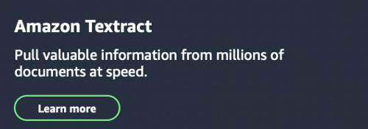
Amazon Rekognition
Automate your image and video analysis with machine learning.

Slide 17
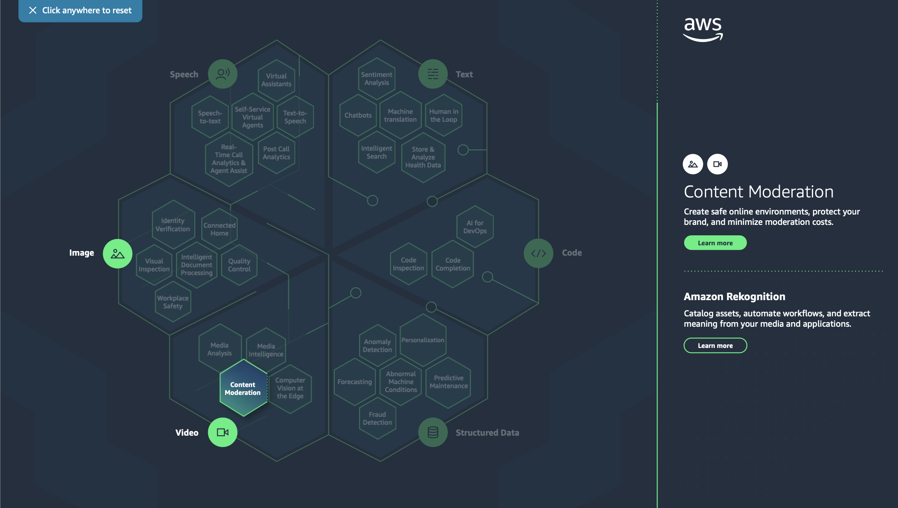
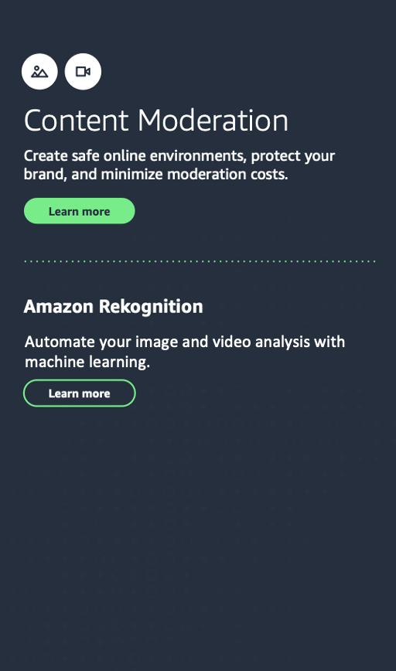

Amazon Transcribe
Enhance your applications and workflows with automatic speech recognition.
Automate your image and video analysis with machine learning.
Amazon Comprehend
Maximize the value of unstructured text with natural language processing (NLP).
Amazon Augmented AI
Easily implement human review of machine learning predictions.

Slide 18
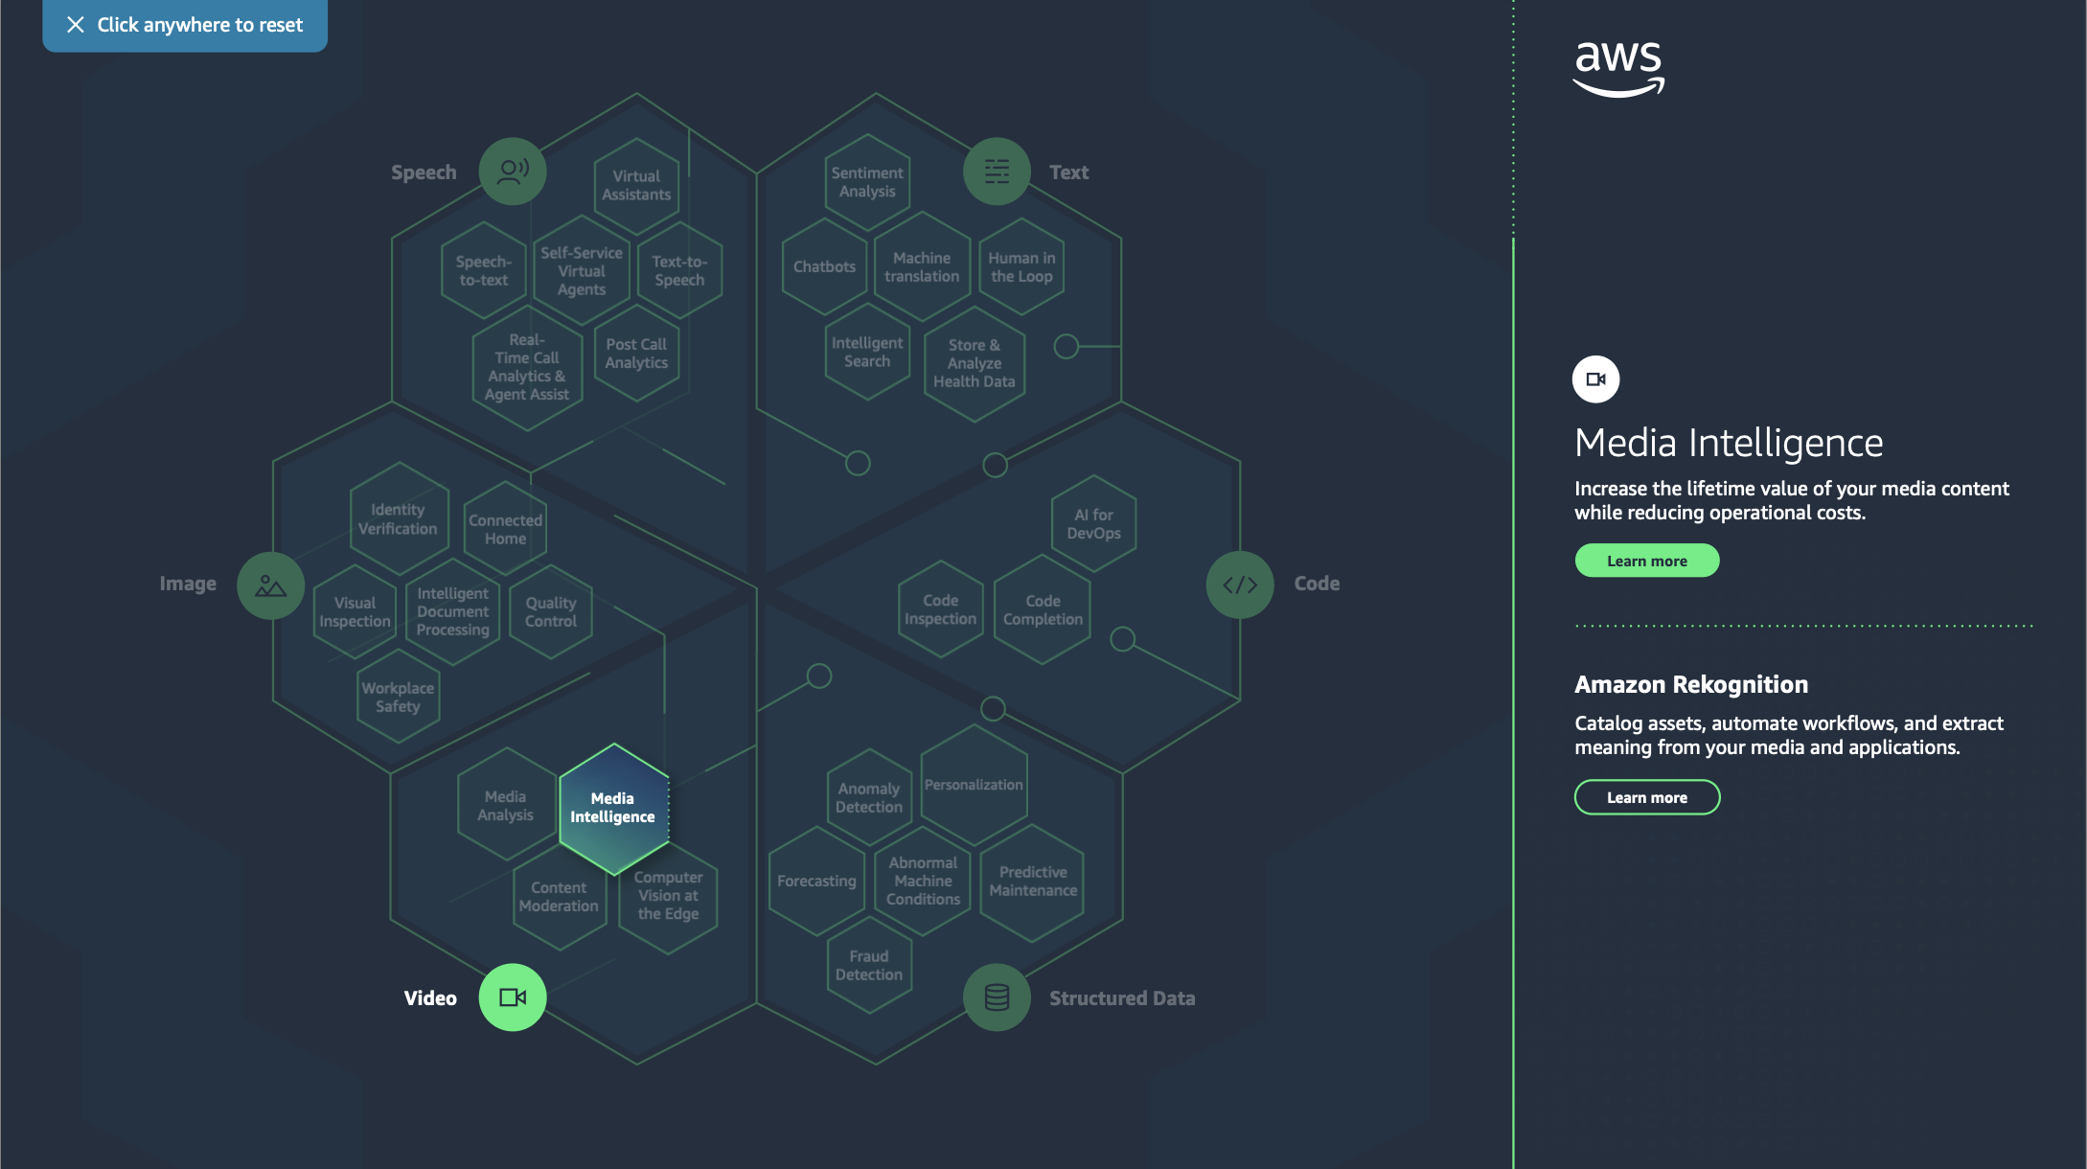
Automate your image and video analysis with machine learning.

Slide 19
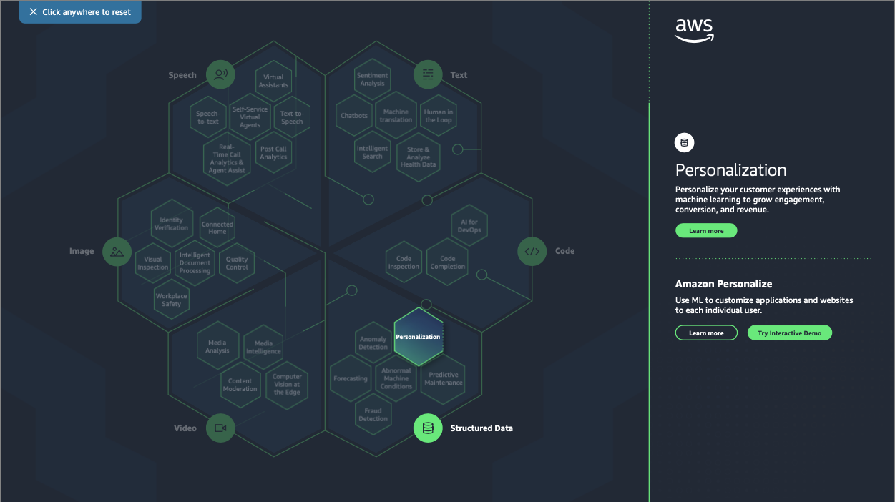

Slide 20
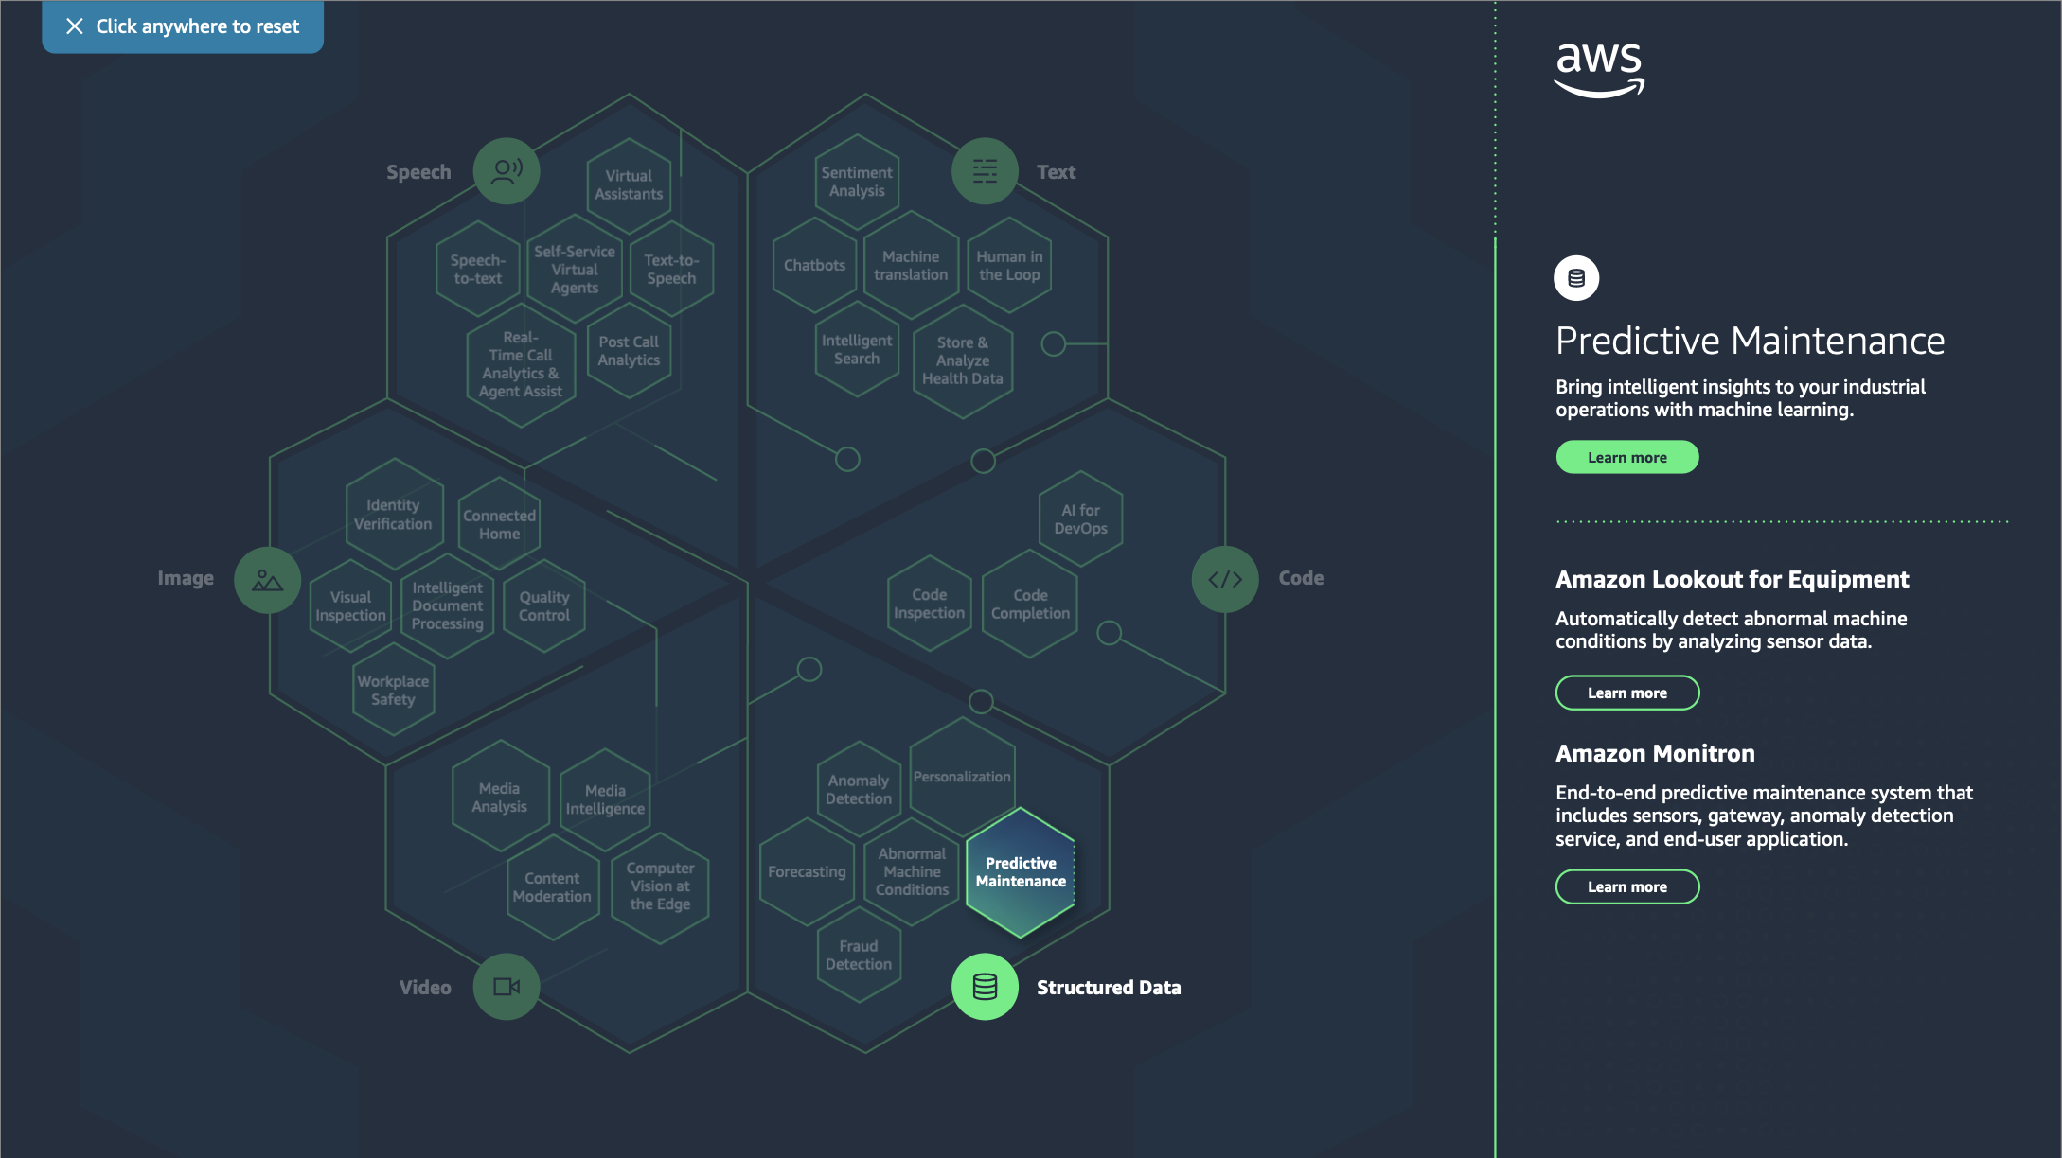

Slide 21
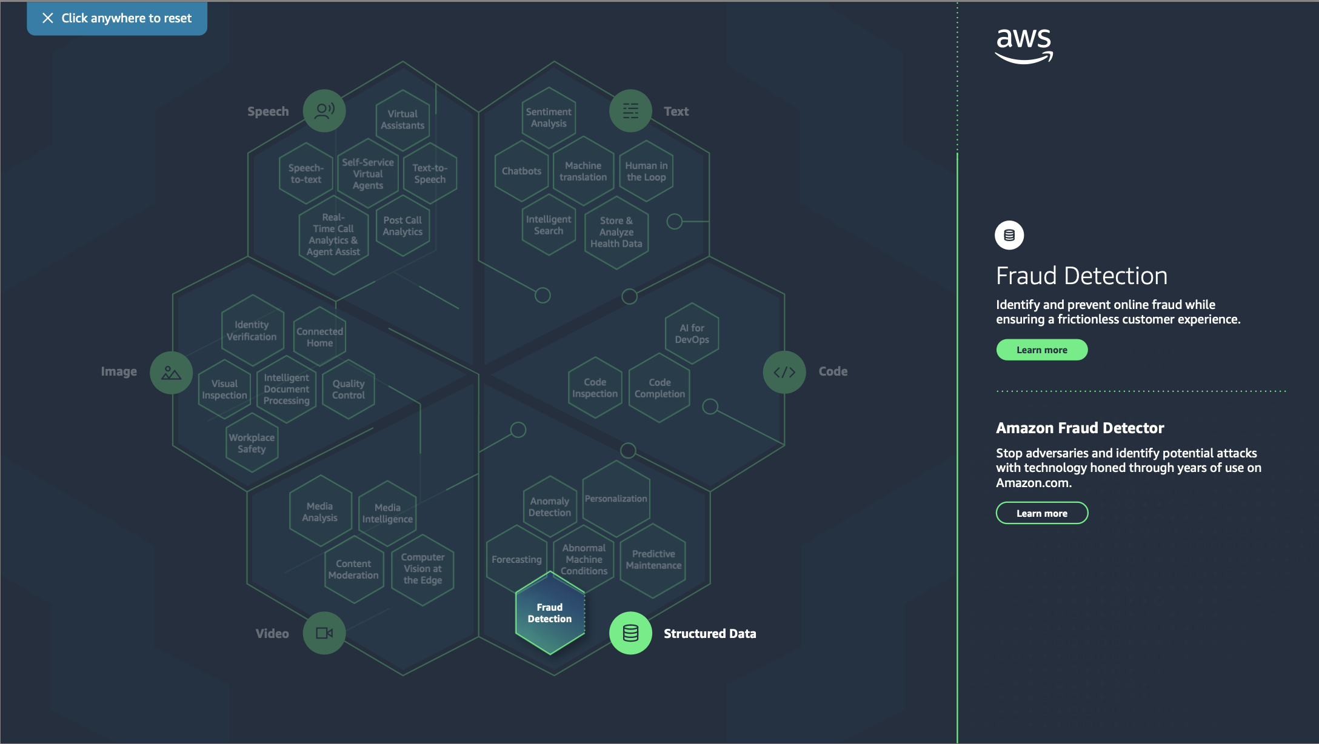

Slide 22
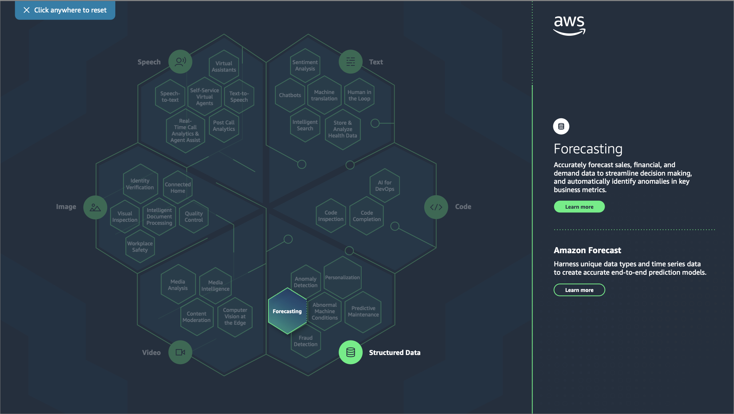

Slide 23
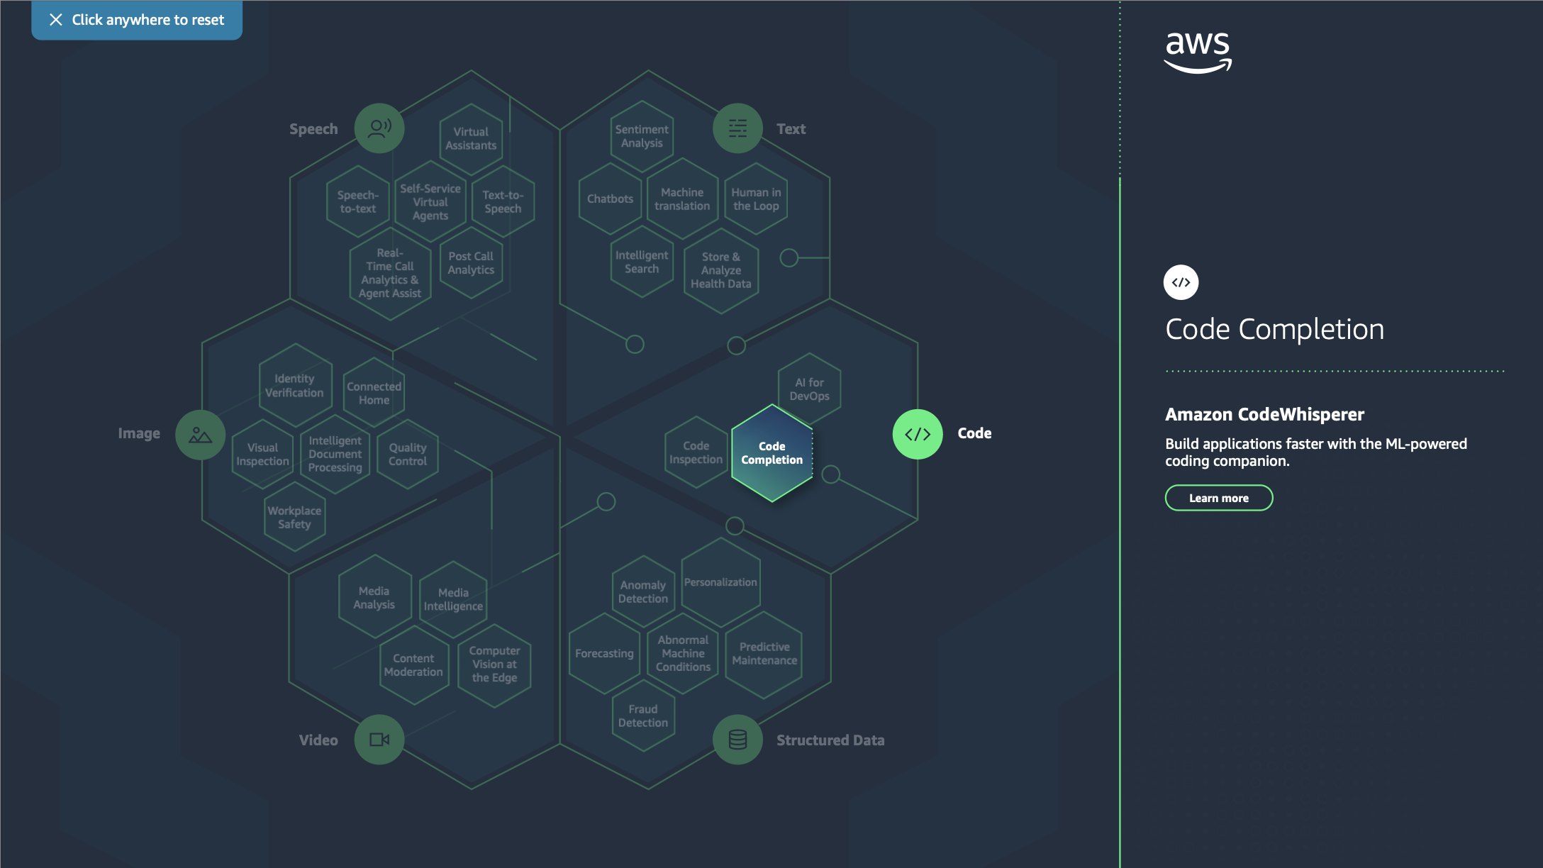

Slide 24
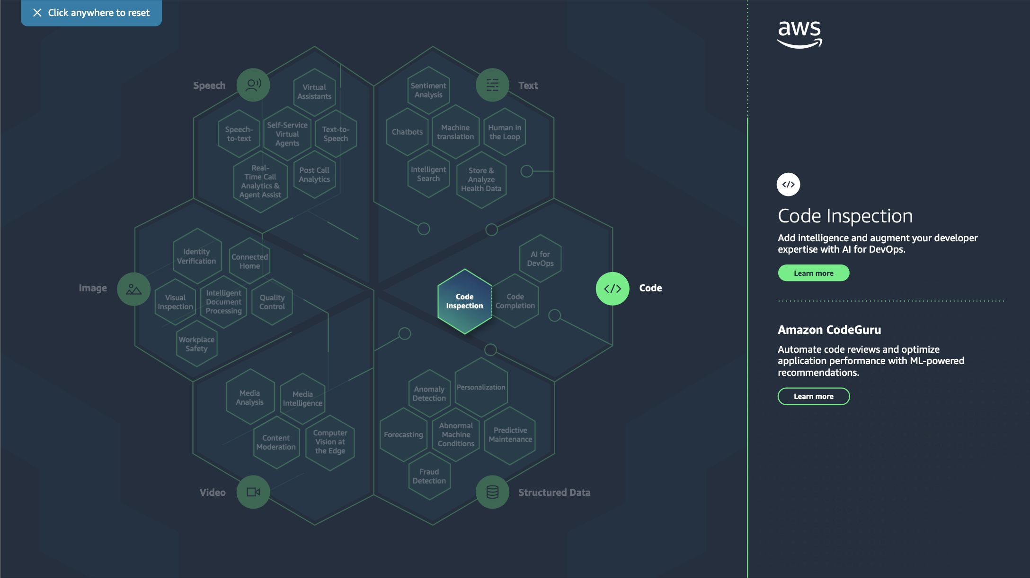

Slide 25

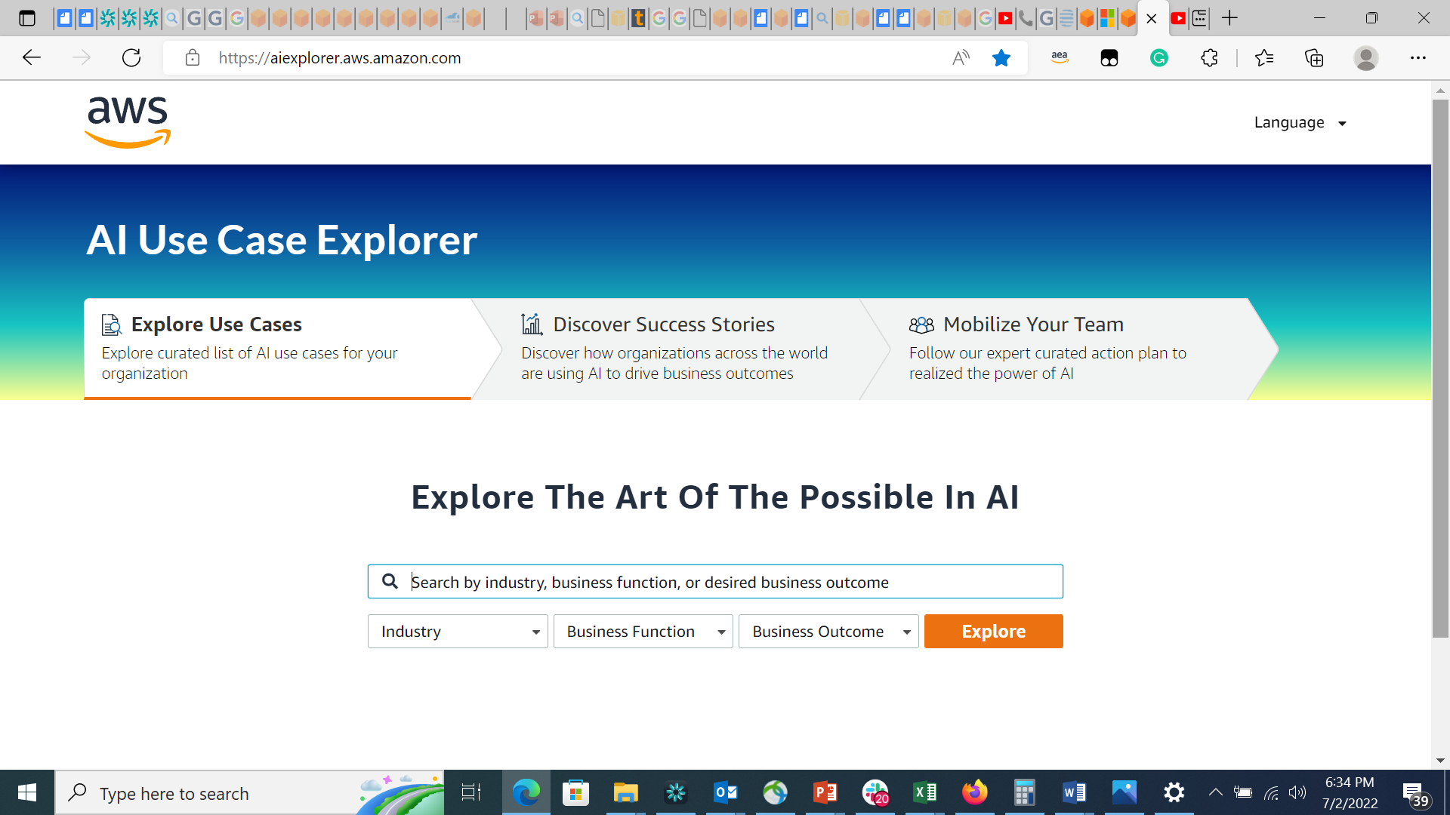

AI Use Case Explorer
Easily find the most relevant AI use cases with related content and guidance to make them real
aiexplorer.aws.amazon.com

Slide 26
Our tool offers 3 main features
Explore use cases
Discover success stories
Mobilize your team
Explore curated list of AI use cases for your organization
Discover how organizations across the world are using AI to drive business outcomes
Follow our expert-curated action plan to realize the power of AI
100+ use cases
and sub use cases
400+ customer success stories
50+ resources
(eBooks, videos, demos)

Slide 27
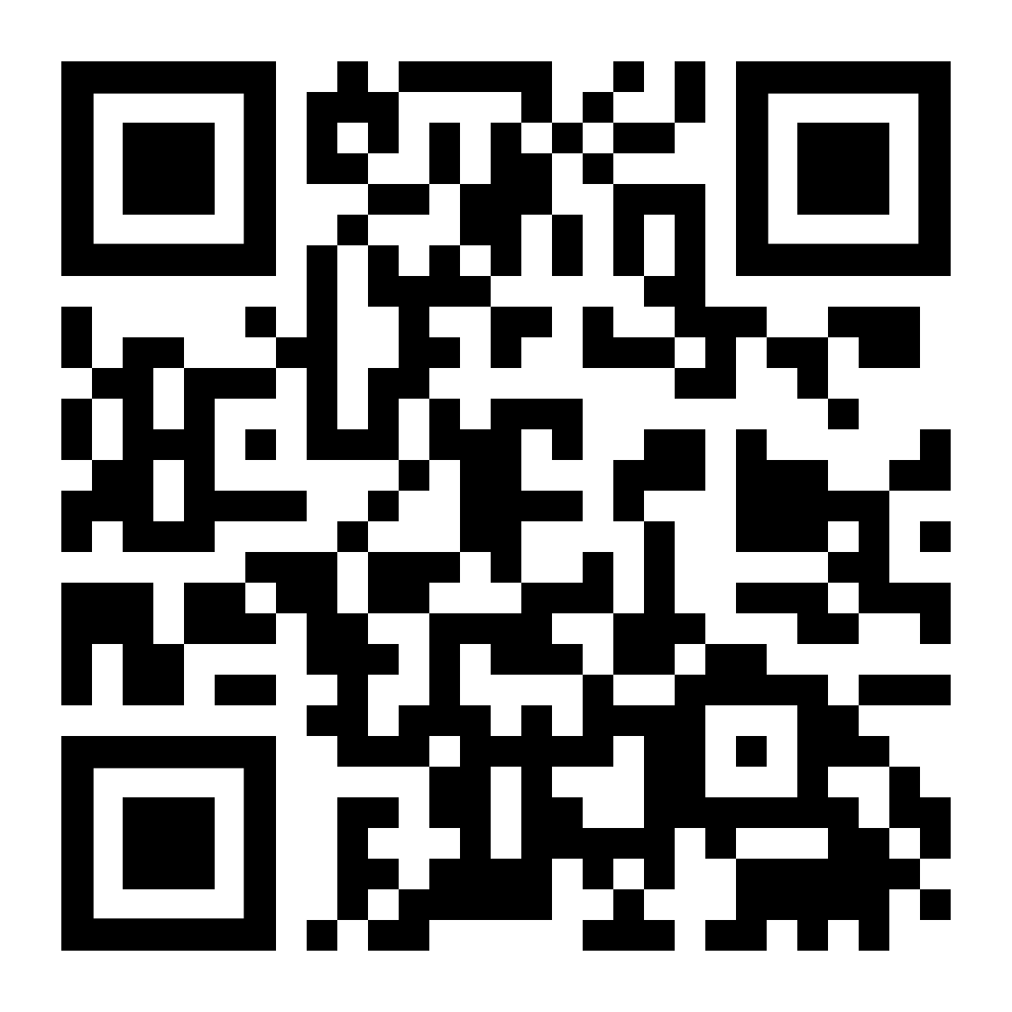
Start exploring AI Services today
Visit
aiexplorer.aws.amazon.com

